Slide 1
Ensemble Learning
So far – learning methods that learn a single hypothesis, chosen form a hypothesis space that is used to make predictions.
Ensemble learning → select a collection (ensemble) of hypotheses and combine their predictions.
Example 1 - generate 100 different decision trees from the same or different training set and have them vote on the best classification for a new example.
Key motivation: reduce the error rate. Hope is that it will become much more unlikely that the ensemble of will misclassify an example.

Slide 2
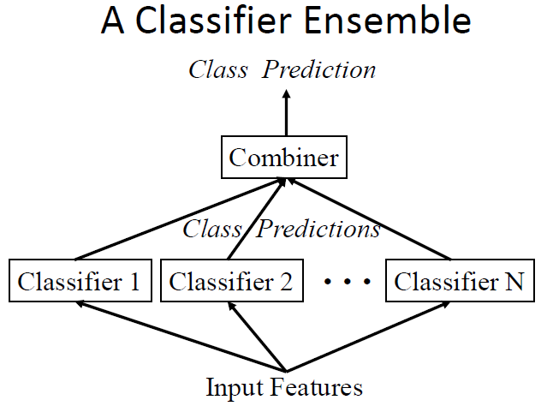
Learning Ensembles
Learn multiple alternative definitions of a concept using different training data or different learning algorithms.
Combine decisions of multiple definitions, e.g. using weighted voting.

Slide 3
Value of Ensembles
“No Free Lunch” Theorem
No single algorithm wins all the time!
When combing multiple independent and diverse decisions each of which is at least more accurate than random guessing, random errors cancel each other out, correct decisions are reinforced.
Source: Ray Mooney

Slide 4
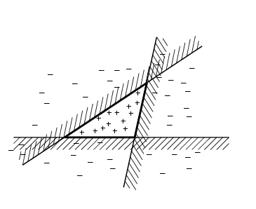
Ensemble Learning
→ way of enlarging the hypothesis space, i.e., the ensemble itself is a hypothesis and the new hypothesis space is the set of all possible ensembles constructible form hypotheses of the original space.
Increasing power of ensemble learning:
Three linear threshold hypothesis
(positive examples on the non-shaded side);
Ensemble classifies as positive any example classified
positively be all three. The resulting triangular region hypothesis
is not expressible in the original hypothesis space.

Slide 5
Necessary and sufficient condition for an ensemble of classifiers to be more accurate than any of its individual members :
The classifiers must be accurate (weak learner). They must be diverse.
An accurate classifier or weak learner is one that has an error rate of better than random guessing (>50%).
Two classifiers are diverse if they make different errors on new data points.
Methods for constructing Ensembles.
Manipulating the training examples
Manipulating the input features
Injecting Randomness

Slide 6
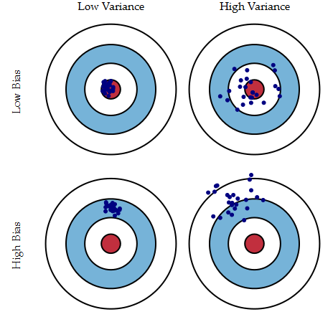
Bias- variance dilemma (slides from previous course)

Slide 7
Error = reducible error + irreducible error
(Due to noise)
Reducible error can be further decomposed into “error due to squared bias” and “error due to variance.”
Err(x)=Bias²+Variance+Irreducible Error
The error due to squared bias is the amount by which the expected model prediction differs from the true value or target, over the training data..
The error due to variance is the amount by which the prediction, over one training set, differs from the expected predicted value, over all the training sets.

Slide 8
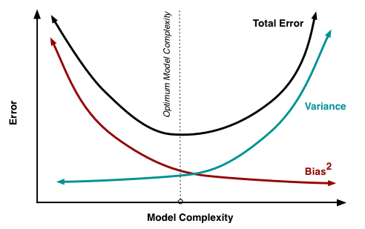
A model which is too simple, or too inflexible, will have a large bias.
A model which has too much flexibility will have high variance.
Average models to reduce model variance

Slide 9
Bootstrap Method.
Cross-validation is without replacement.
The bootstrap allows us to calculate estimates in situations where there is no adequate statistical theory (when the population is not normal and the sample size is small).
Suppose we obtained a sample of n observations from some unknown distribution, F. We call the original sample X.
Our goal is to know about a parameter, θ, of the original
distribution (for example: mean, median)
A bootstrap sample is a sample with replacement of size n from the original sample. It is denoted by X*.

Slide 10
Bagging
Create ensembles by “bootstrap aggregation”, i.e., repeatedly randomly resampling the training data).
Bootstrap: draw N items from X with replacement
Each bootstrap sample will on average contain 63.2% of the unique training examples, the rest are replicates.
Bagging
Train M learners on M bootstrap samples
Combine outputs by voting (e.g., majority vote)
Decreases error by decreasing the variance in the results due to unstable learners, algorithms (like decision trees and neural networks) whose output can change dramatically when the training data is slightly changed.

Slide 11
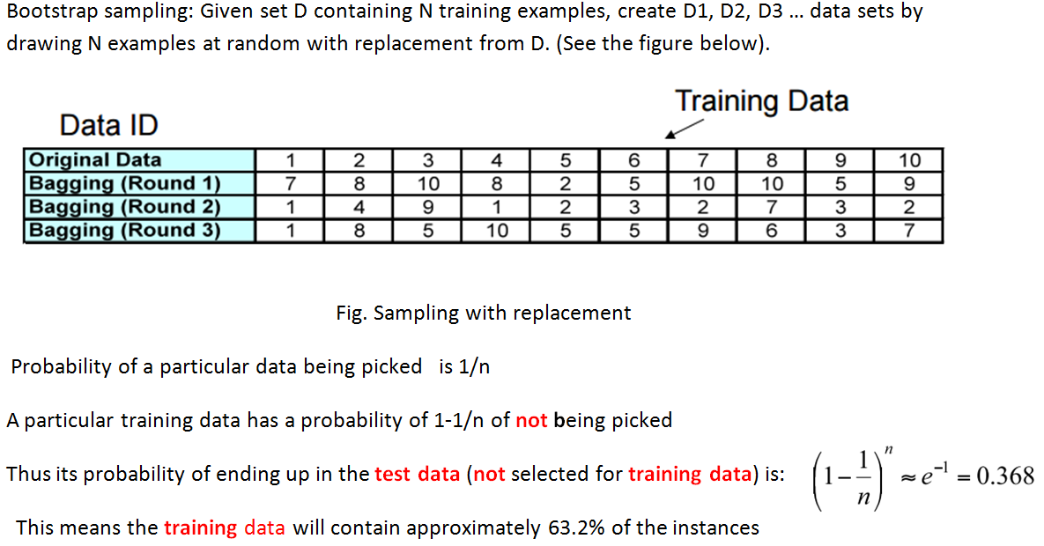
Suppose n=500. (1-1/500)⁵⁰⁰ ≈ ¹/_{e} ≈ .368

Slide 12
Boosting
Introduced by Schapire and Freund in 1996.
Build new models that try to do better on previous model's mis-classifications
Can get better accuracy
Tends to overfit
Consider creating three component classifiers for a two-category problem through boosting.
Randomly select n₁ < n samples from D without replacement to obtain D₁
Train weak learner C₁
Select n₂ < n samples from D with half of the samples misclassified by C₁ to obtain D₂
Train weak learner C₂
Select all remaining samples from D that C₁ and C₂ disagree on
Train weak learner C₃
Final classifier is vote of weak learners
D
D3
D1
D2
-
+
+
-
Notes:
The goal of boosting is to improve the accuracy of any given learning algorithm.
Consider creating three component classifiers for a two-category problem through boosting.
First, ……, call this set D1. Based on D1, train the first classifier, C1.
Now, we seek a second training set D2, half of the patterns in D2 should be correctly classified by C1, half incorrectly classified by C1.
Next, we seek a third data set D3,

